Slide 1
Smart Study Planner
CAPSTONE PROJECT
“Streamlining Smart Study Planner with Real-time Progress Monitoring”
Presented By:
Shanu Ahmed - Veer Madho Singh Bhandari Uttarakhand Technical University, Dehradun, India - B-Tech CSE
STU65b50fd62d8351706364886

Slide 2
OUTLINE
Problem Statement (Should not include solution)
System Development Approach (Technology Used)
Algorithm & Deployment (Step by Step Procedure)
Result
Conclusion
Future Scope(Optional)
References

Slide 3
PROBLEM STATEMENT
. Disorganized Study Scheduling:
Students struggle to create structured study plans
No systematic approach to allocate time for subjects
Difficulty visualizing study timelines and deadlines
Missing centralized system for academic commitments
Poor Task Management & Tracking:
Inability to effectively prioritize academic tasks
No reliable method to set and monitor study goals
Difficulty remembering deadlines and study sessions
Lack of visual progress indicators for academic work
Time Management Challenges:
Students cannot maintain consistent study routines
No tools for proven study techniques (like Pomodoro)
Difficulty tracking time spent on different subjects
Poor awareness of study patterns and productivity
Data Persistence Issues:
Study plans lost when switching devices
No offline access to schedules and task lists
Inability to sync study data across sessions
Missing portable academic organization system

Slide 4
SYSTEM APPROACH
Frontend Technologies:
HTML5: Semantic structure, forms, local storage API support
CSS3: Flexbox/Grid layouts, theming with variables, responsive design
JavaScript (ES6+): DOM manipulation, event handling, local storage management
Design Approach:
Clean and user-friendly interface
Mobile-responsive design
Modular separation of HTML, CSS, and JS files

Slide 5
SYSTEM APPROACH
HTML – Structure & Accessibility
Defined the overall page layout (header, task list section, footer).
Built task forms for adding/editing tasks.
Used semantic elements (form, button, section) for clarity and accessibility.
Integrated deadline and priority inputs directly in the markup.
Provided the foundation for JavaScript and CSS integration.

Slide 6
SYSTEM APPROACH
CSS – Styling & Responsive Design
Implemented flexbox and grid for adaptive layouts.
Designed dark/light theme toggle using CSS variables.
Styled progress bars, priority labels, and deadlines for clear visual cues.
Added animations and hover effects for smoother interactions.
Used media queries for full responsiveness (desktop → mobile).

Slide 7
SYSTEM APPROACH
JavaScript – Logic & Interactivity
Powered CRUD operations (create, edit, delete, complete tasks).
Managed localStorage persistence to save tasks across sessions.
Calculated progress percentage dynamically as tasks updated.
Built time tracking functions (start, stop, efficiency calculation).
Implemented sorting, filtering, and search features.

Slide 8
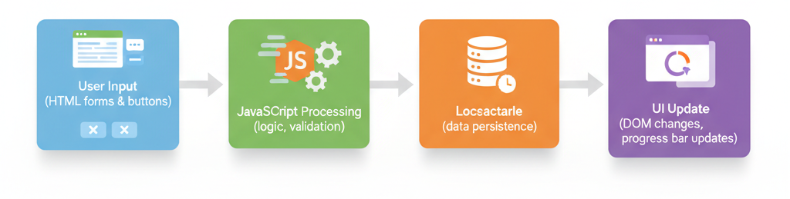
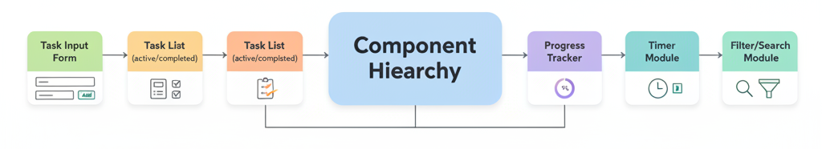
ALGORITHM & DEPLOYMENT
System Architecture Overview
Client-Side Single Page Application (no backend server).
Data Flow:
Component Hierarchy:

Slide 9
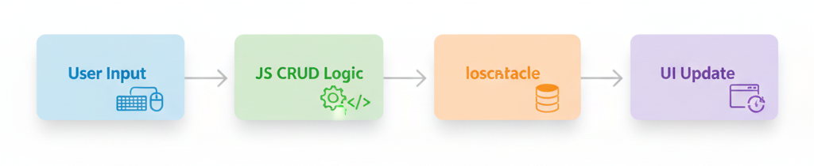
ALGORITHM & DEPLOYMENT
Task Management Algorithm
Input: User task data (title, description, priority, deadline).
Processing:
Create → Save new task in localStorage.
Read → Load tasks on page load.
Update → Edit task details, status, or priority.
Delete → Remove task from localStorage.
Output: Organized and updated task list.
Flow:

Slide 10
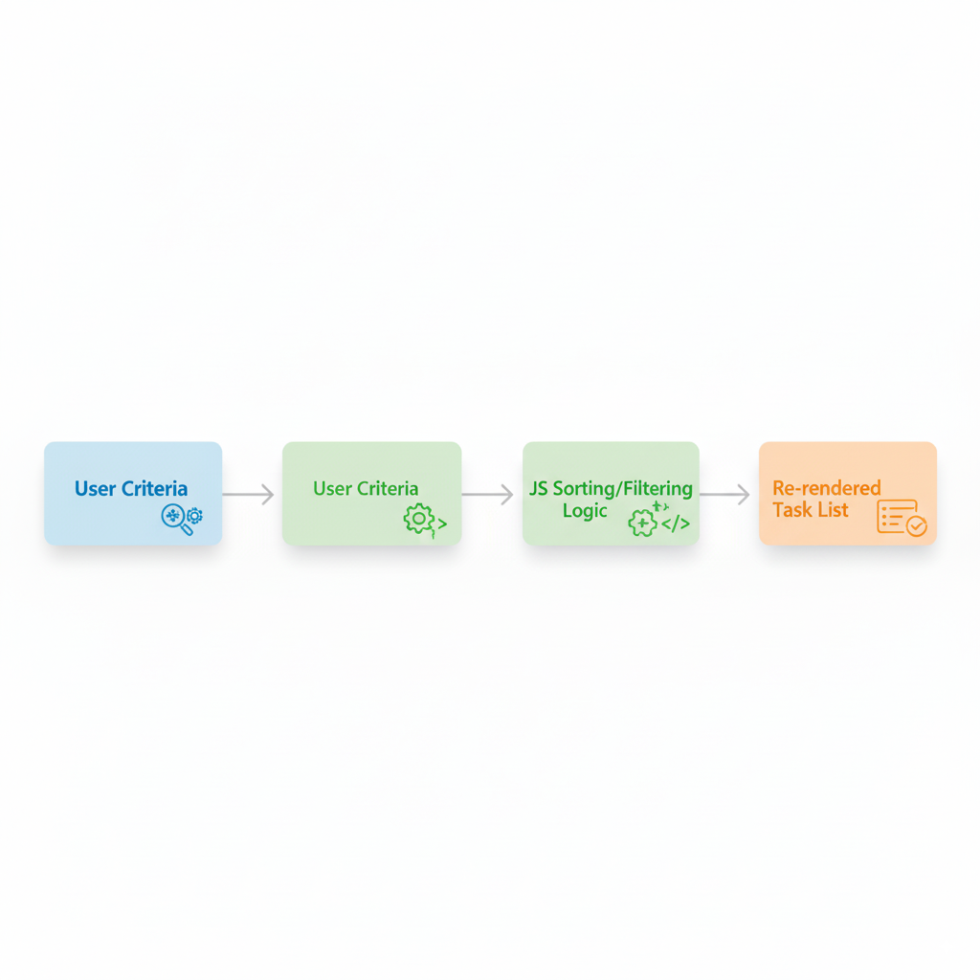
ALGORITHM & DEPLOYMENT
Sorting, Filtering & Search Algorithms
Data Structure:
Tasks Array: Object-based with smart prioritization
Session Logs: Time-stamped study records with metadata
Subject Registry: Categorized knowledge domain
Progress Metrics: Completion analytics & time intelligence
Filtering Algorithms:
Filter by status (completed/pending), priority, or deadline proximity.
Search Algorithm:
Real-time search → Filters tasks as user types by title or description.
Workflow:

Slide 11
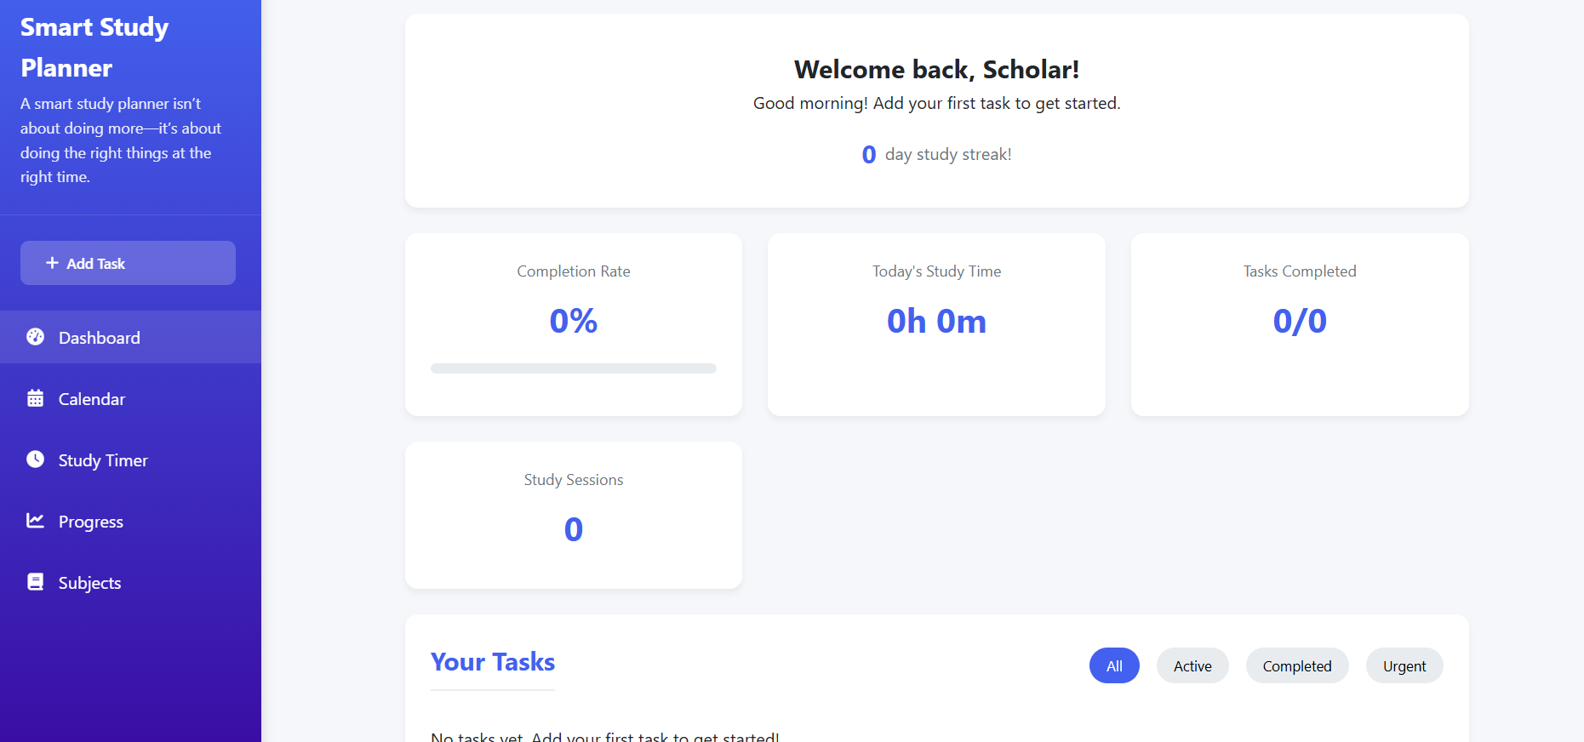
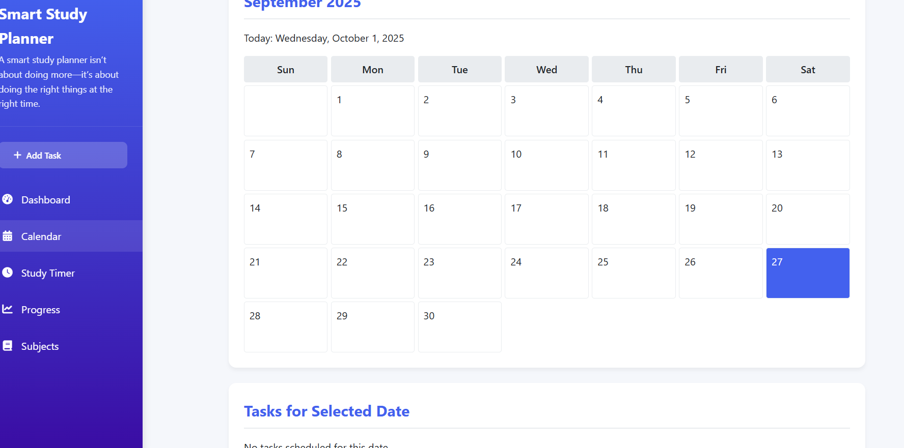
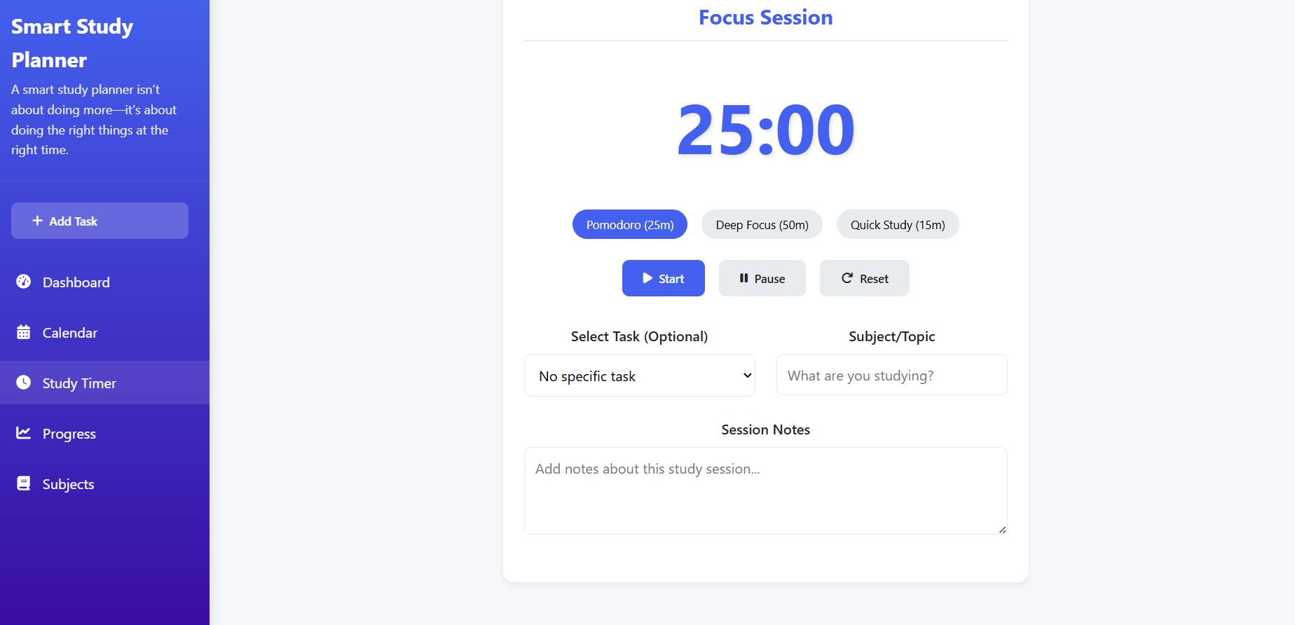
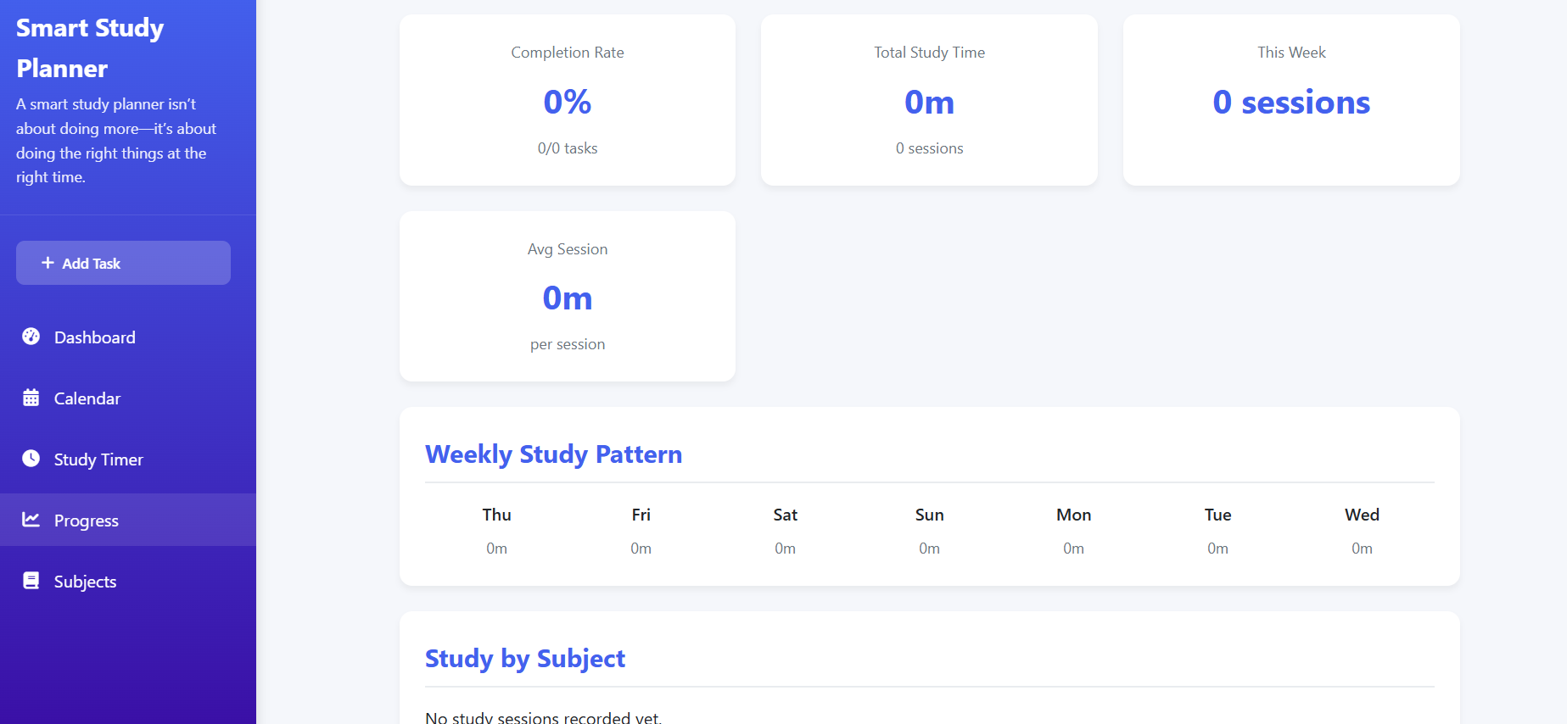
RESULT
Github repo:https://github.com/4hmedshanu/Edunet_Foundation_IBM_SkillsBuild_Intership_--Smart-Study-Planner
Application link: https://smart-study-planner-projt.vercel.app/

Slide 12
CONCLUSION
Key Takeaways:
Addressed major productivity challenges in task management.
Achieved core objectives: intuitive UI, real-time tracking, time management.
Delivered reliable and responsive web app with local data persistence.
Value Proposition:
Enhances personal productivity and task visibility.
Simple, accessible, and cross-device compatible.
Provides a strong foundation for future feature expansion.

Slide 13
FUTURE SCOPE(OPTIONAL)
Planned Enhancements:
Cloud synchronization for multi-device access.
Dedicated mobile app (Android/iOS).
Advanced analytics with detailed productivity reports.
Team collaboration & shared task lists.
AI-powered task prioritization and suggestions.
Integration with popular calendars (Google, Outlook).

Slide 14
REFERENCES
Technical References:
MDN Web Docs (HTML5, CSS3, JavaScript).
W3C standards for semantic web development.
Development Tools:
Git & GitHub for version control.
Browser DevTools for debugging.
VS Code
Learning Resources:
Online tutorials, IBM SkillsBuild
UI/UX design guidelines and accessibility principles.

Slide 15
THANK YOU

